Slide 1
EV Charging Stations Load Forecasting Using Learning Techniques
Oscar Wahlström, Fournier Camille, Yann Lefloch, & Anujraaj Gopalsamy Sakthivel
Supervisors: Manar Amayri & Nana Kofi Baabu Twum-Duah

Slide 2
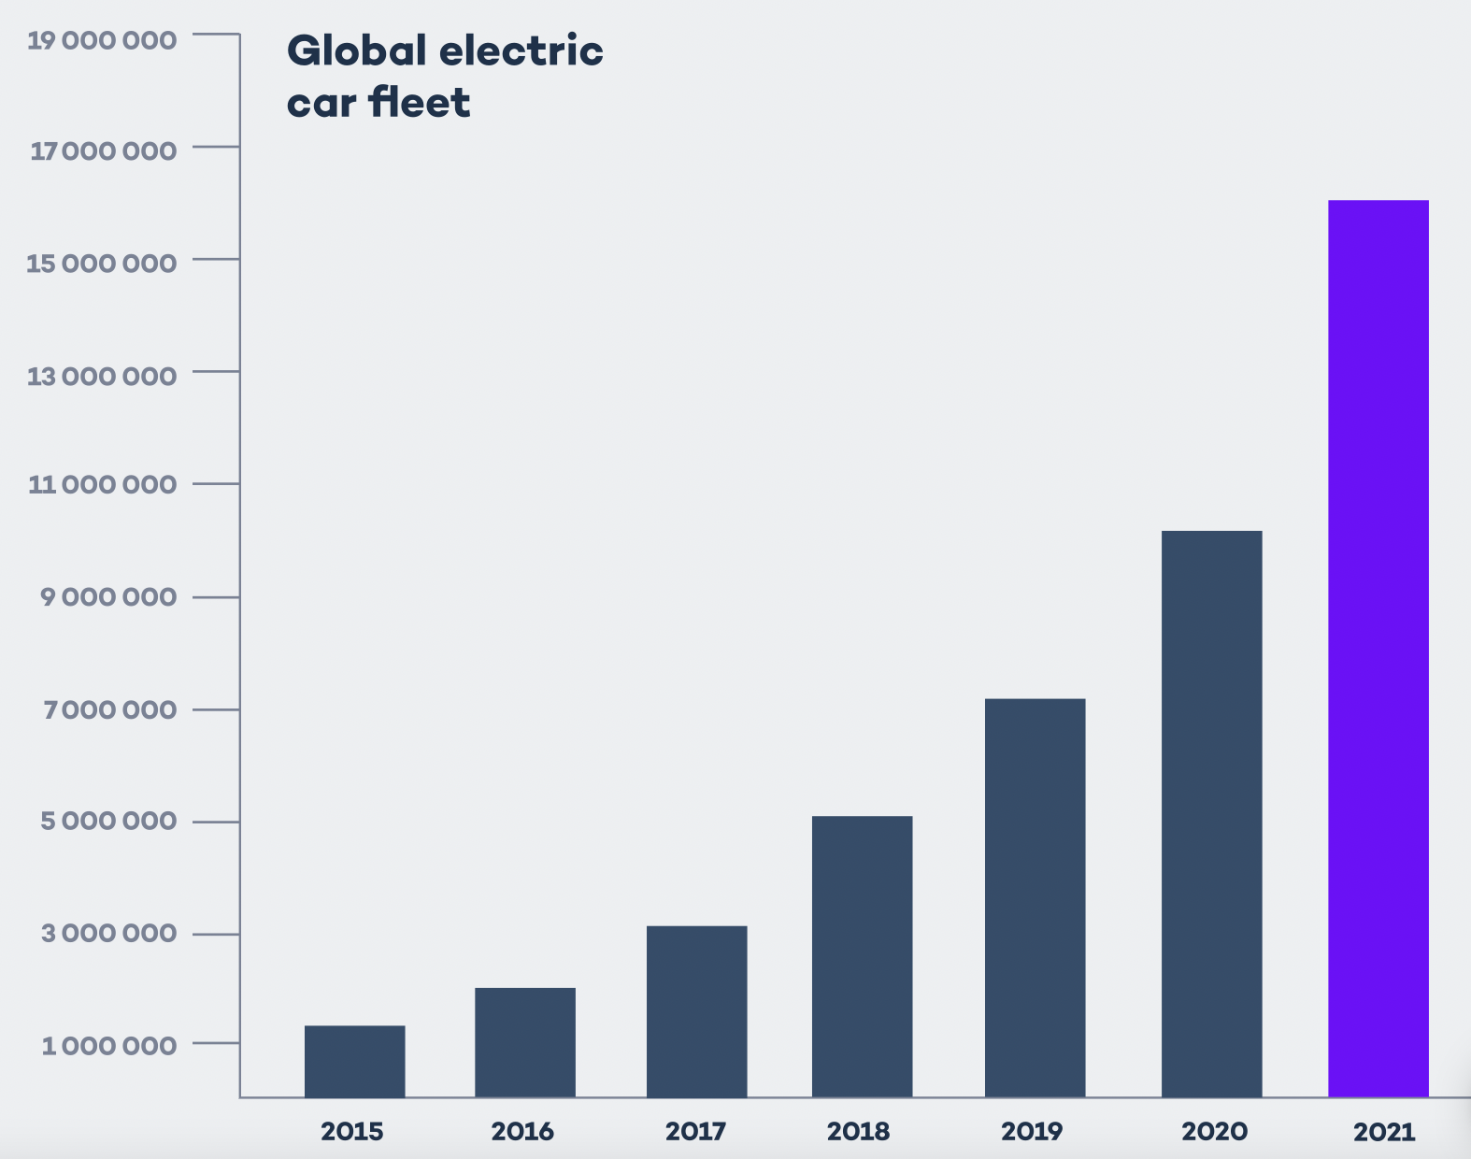

Upgraded description of the project
Why are we doing this?
Reduce peak load
Reduce price for consumers
Reduce carbon expensive energies
Obtain a better understanding of the school’s
EV-chargers
How are we doing it?
Analysing EV load of the 4 chargers using different ML-models
Adding different features
Goal - Achieve the highest R2-score.

Slide 3
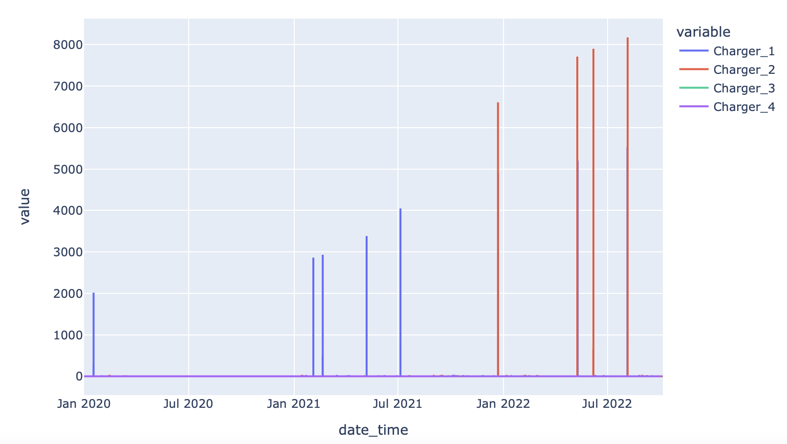
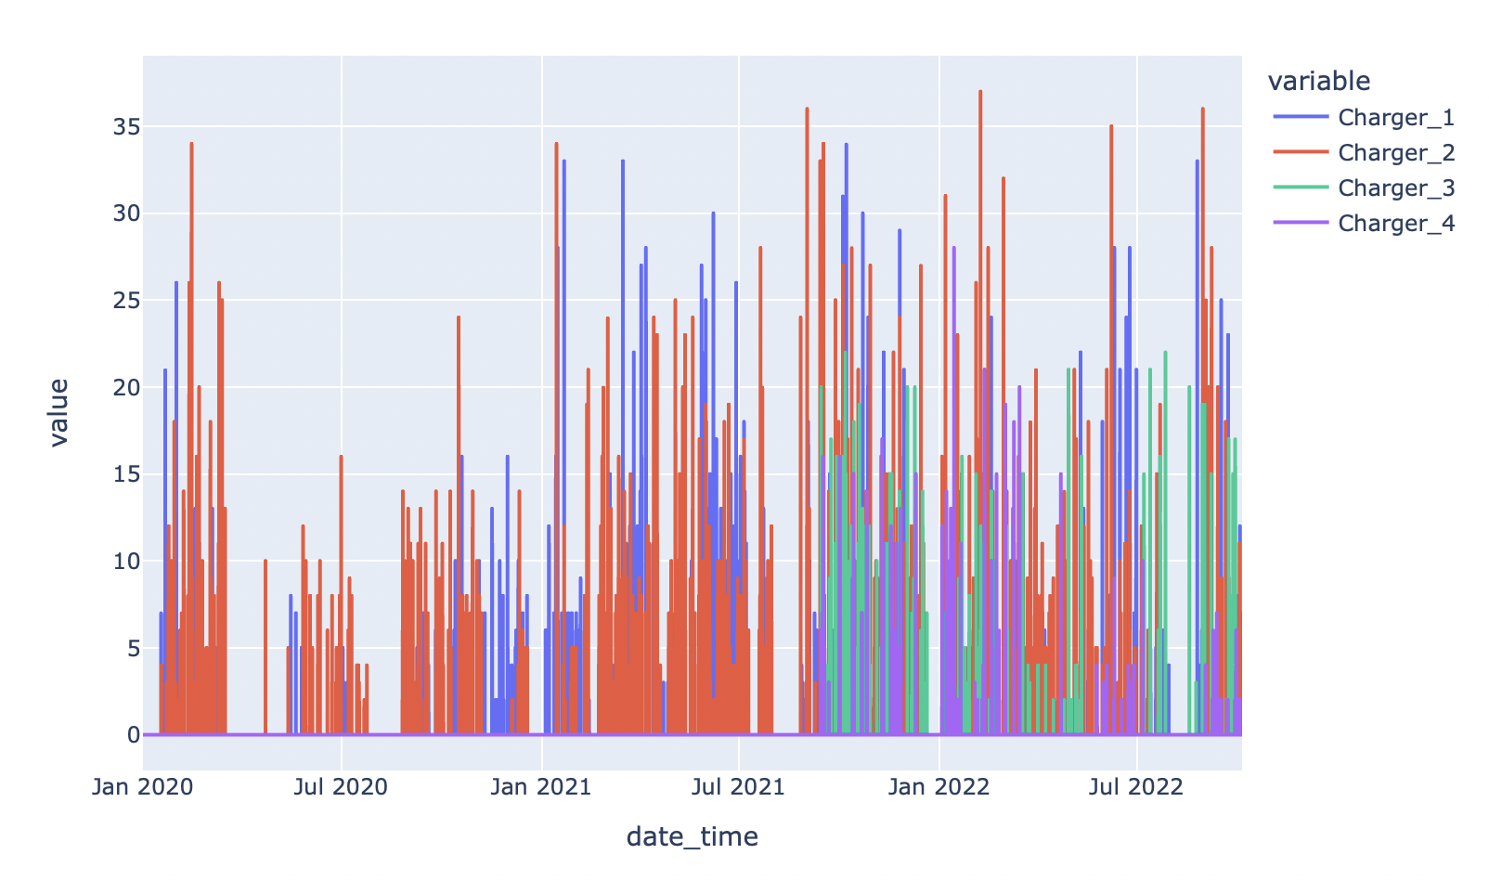
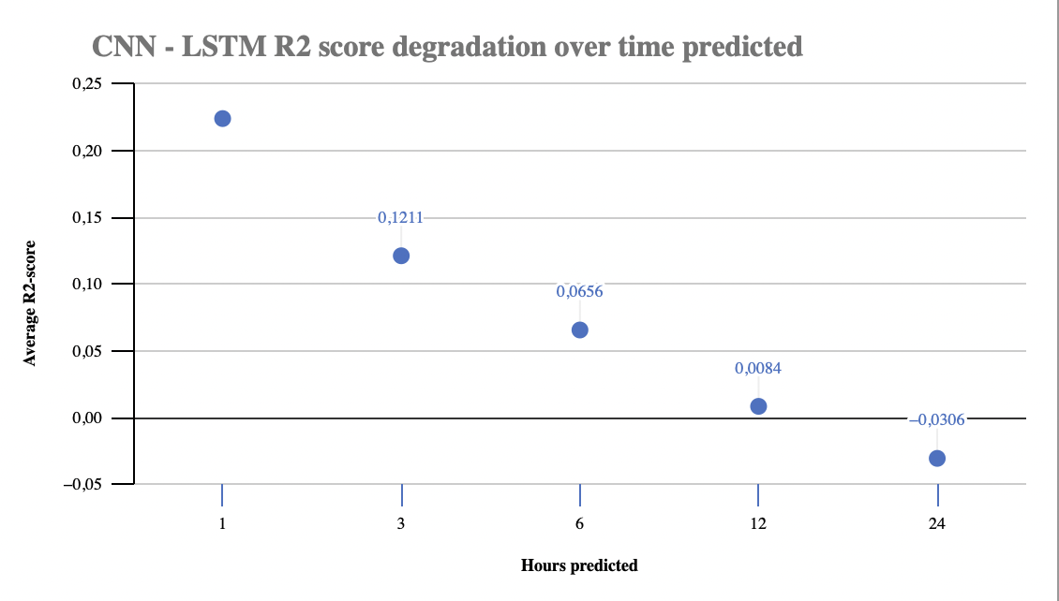
Updated planning of the project (1)
Understanding last year group’s work using Deep note for code sharing
Analyze our data (identifying and removing outliers in the data)
Modify existing model from last year for EV load forecasting with historical data
Arima, LSTM, CNN-LSTM, and Lightgbm to predict with only the consumption data are first used
Analyse the first results using R2 as the metric :
What is the best model with only the consumption data :
Notes:
R2 score regression metric to compare model

Slide 4



Future work
1. Finding new features using a survey of the charger’s user
2. Finding the better-performing model for the EV load forecasting
- CNN-LSTM
- LightGBM
- More advanced models
3. Optimise the hyperparameter of the model and select the most relevant error metrics
4. Validate the proposed models using the EV charging station and an MPC where the objective function is to maximize the self-consumption of the Predis-MHI platform.
Notes:
1. Find features that have a better correlation to the EV load data
- Calendar features
- EV user data collected from the survey
2. Find the better-performing model for the EV load forecasting
- CNN-LSTM
- LightGBM
3. Optimise the hyperparameter of the model and select the most relevant error metrics
4. Validate the proposed models using the EV charging station and an MPC where the objective function is to maximize the self-consumption of the Predis-MHI platform.

Slide 5




Challenges
Understanding the data and the previous code
Limited availability of data
Long computation time
Solutions: Most of the issues are solved by asking for help, we identify what we don’t understand and we search for the answers and if need be for the support of our project leader.
Notes:
External: understanding the data we have (nb of chargers, value measured, how there could be outliers), not a lot of data (prediction could be better maybe if training with a larger set of data), covid in the middle of the measured data (not normal behaviour)
Internal Taking over the project : understanding last year group’s code, understanding how the different model works and how they were implemented and the approach they had on the parameters.
Limited experience with machine learning which means everything is taking time to understand the approach and the way of using it.
Solutions: Most of the issues are solved by asking for help, we identify what we don’t understand and we search for the answers and if need be for the support of our project leader

Slide 6



Conclusion and perspective
EV sales are increasing rapidly globally and in France.
User data
Using AI to forecast the future load
Notes:
The recent years have seen a great increase in the sales and stock of EVs in Europe and in France and it is projected to grow in the coming decades. To plan the electrical systems to cope with the incrasing load from EVs, it is prudent to predict the Ev load. We employ machine learning based algorithms to forecast the load of the electric chargers and Since the EV charger loads are random and depends on the user data, we will proceed to collect the user data from the EV user in the Greener building and proceed to forecast the load with the ML models.

